Slide 1
Open Source Platform and Network Administration
Lesson 3

Slide 2
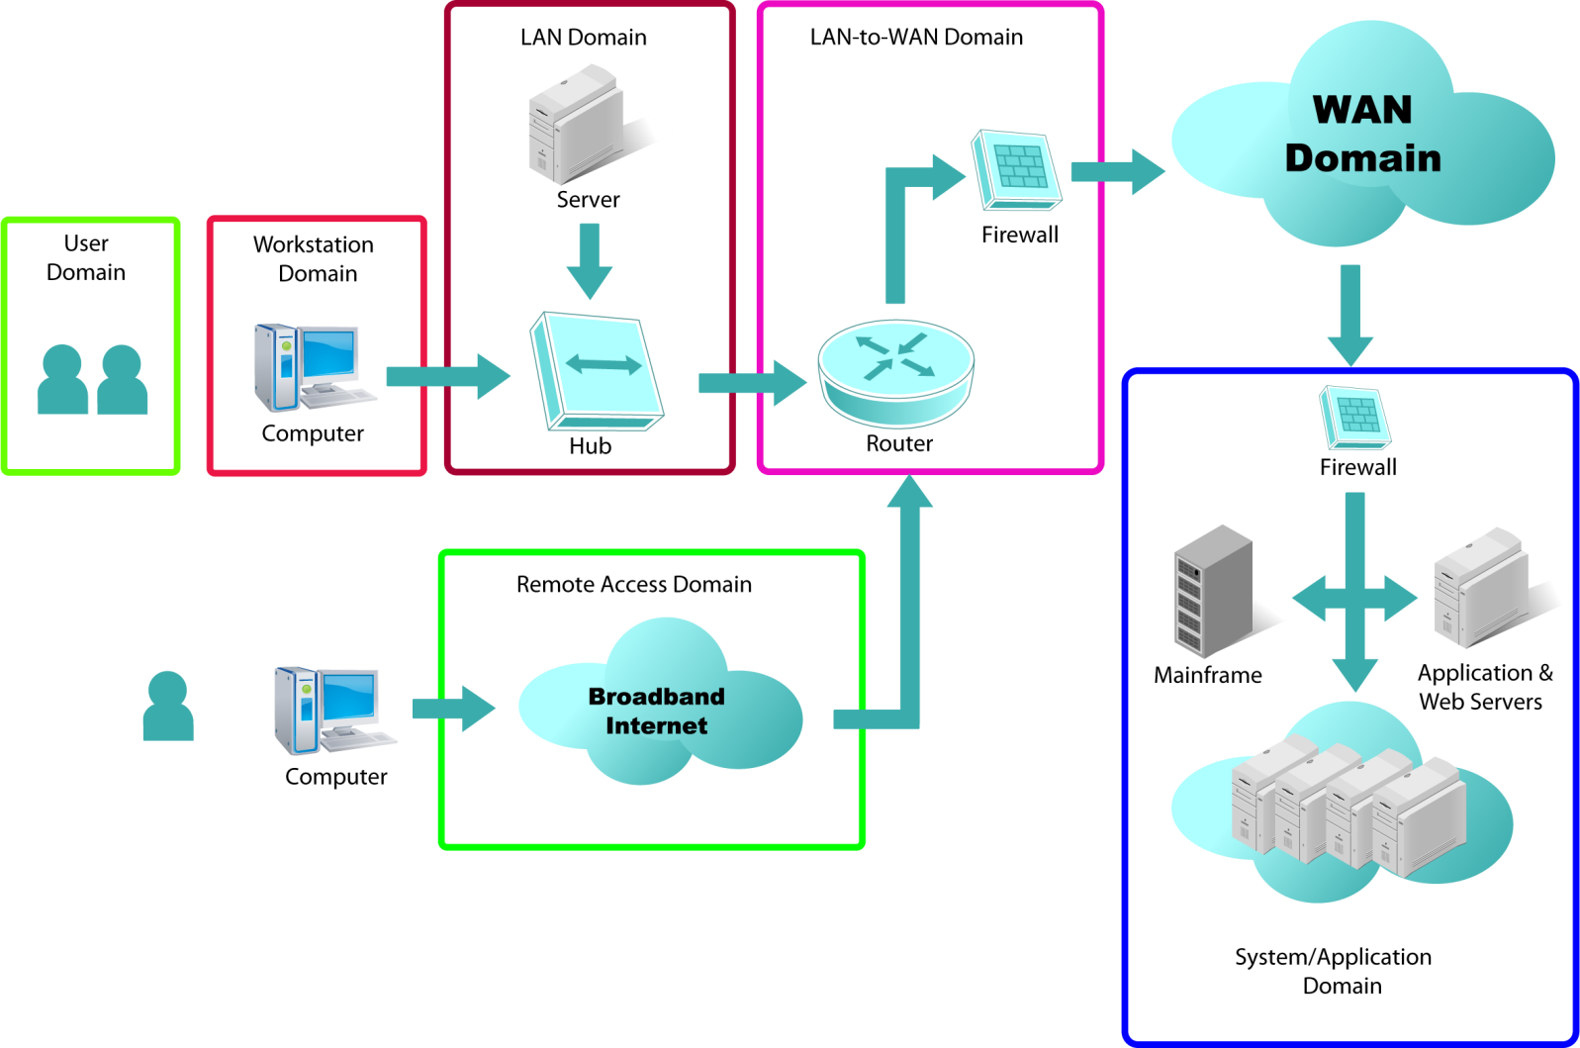
Seven Domains of a Typical IT Infrastructure

Slide 3
Linux in the Seven Domains
User Domain
Workstation Domain
LAN Domain
WAN Domain

Slide 4
Linux in the Seven Domains (Continued)
LAN-to-WAN Domain
Remote Access Domain
System Domain

Slide 5
Open Source Productivity Applications
Firefox Web browser
OpenOffice.org suite
Thunderbird e-mail client
Scribus desktop
Kino video editor

Slide 6
Virtual Machine (VM)
A VM can be a:
Hardware VM or Hypervisor
Type1—runs on native machines
Type2—runs on host operating systems as guest
Application VM
Java VM and Dalvik VM
Adobe Flash Player

Slide 7
Advantages of a Hypervisor
Saves money on hardware and power
Well-positioned for bastion hosts
Makes better use of hardware resources
Easier to manage

Slide 8
Popular VM Software Used with Linux
VM | Licensing | Vendor
VirtualBox | Dual open source and commercial | Sun/Oracle
VMware server | Commercial | VMware
Xen | Open source and commercial | Citrix

Slide 9
Summary
Linux in the seven domains and various open source productivity applications
Facts about the use of Linux in the market
Responsibilities and tasks of a Linux system administrator
Process to define a security framework
Linux in the VM market and various VM software used with Linux

Slide 10
Virtual Lab
Installing a Core Linux Operating System on a Server
Notes:
If your educational institution included the Jones & Bartlett labs as part of the course curriculum, use this script to introduce the lab:
"In this lesson, you were introduced to the Linux environment. You learned that compared to other operating systems, fewer viruses, worms, and other malware are written for Linux, but because most Linux software is released with open source code which makes it easier for someone with malintent to break into a system. You discovered that in this environment, the kernel is customizable and the administrator can configure the security controls in the manner that works best for the organization.
In this lab, you will learn how to install the Linux CentOS operating system in a secure manner. You will create a new virtual machine, partition the hard drive, and install the Linux operating system. You also will create a non-root user account and verify that key services are (or are not) running.”

